Slide 1
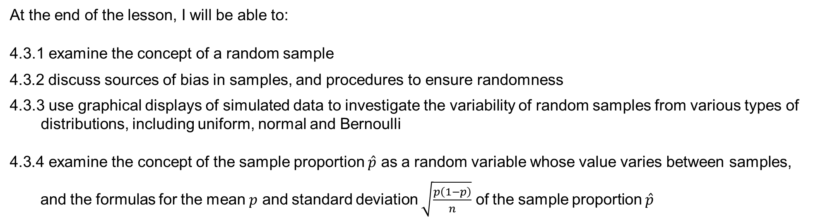
Learning Objective
I will be able to select a sampling methods and address any bias-ness in samples
Success Criteria
At the end of the lesson, I will be able to:
4.3.1 examine the concept of a random sample
4.3.2 discuss sources of bias in samples, and procedures to ensure randomness
4.3.3 use graphical displays of simulated data to investigate the variability of random samples from various types of distributions, including uniform, normal and Bernoulli
4.3.4 examine the concept of the sample proportion $\hat{p}$ as a random variable whose value varies between samples, and the formulas for the mean $p$ and standard deviation $\sqrt{\frac{p\left(1−p\right)}{n}}$ of the sample proportion $\hat{p}$

Slide 2
Vocabulary
Primary Data: Data which is collected by the organisation that is going to use for statistical analysis. It may be collected by:
Direct observation
Interviews
Questionnaires
Surveys
Secondary Data: Data which is obtained by some external sources such as:
Newspapers
Internet
Television
Agencies such as the Australian Bureau of Statistics
Secondary data is easy to acquire and process is not as expensive but data may have been refined, and its originality may be lost.

Slide 3
Samples and Population
Census: Involves the entire population to be considered.
Population: The set of all eligible members of a group which we intend to study
Example: If we are interested in the Methods sores of the Year 12 students in the whole of Western Australia. This group of students could be considered a population.
Sample: Since the entire population is too big to study, we obtain a sample from the population instead. A sample is a subset of the entire population.
Example: If we choose to look at the scores of Year 12 students from 3-4 schools
Random sample is a subset of the entire population that has been formed in such a way that every member from the population has a non-zero probability of being selected for the sample. We will look at a number of ways we can look at obtaining a random sample such as if it is a simple random sample, then all members have an equal chance of being selected.

Slide 4
Forming a Random Sample
Simple random samples
At the start of the process, every member from the population will be allocated a unique number and the number is then randomly drawn. In this case, every member has an equal chance of being chosen
Disadvantage: We could end up with a sample such that the sample may consist predominantly of the same gender or age group. In which, this sample would no longer be a good representative of the population
Systematic or interval
Similar to above, at the start of the process, every member from the population will be allocated a unique number and a number is selected at every interval between them. Eg. selecting every 5th number.
Disadvantage: Only at the start of the sampling process with the first selection be random. Once the first number is chosen, the other numbers forming the sample are automatically selected hence those outside the interval have no longer any chance of being selected.
Stratified samples
Population is first divided into layers such as homogeneous groups. Then either using simple random sampling or systematic sampling to select the sample by taking samples within the layers.
Disadvantage: Not all members of the population have an equal chance of being selected. Constructing stratified samples can be both time consuming, labour intensive and expensive.
Cluster samples
Population is divided into subgroups or clusters and a set of these clusters will be selected to be the sample.
Disadvantage: All members of the selected cluster are selected but those outside the selected clusters will not be selected

Slide 5
Random Sampling
To ensure a sample is random, such that all members of the population have an equal chance of being selected, we:
Assign a number to every member of the population. If we are not dealing with people, but maybe an area, we can divide the total area into equal regions and assign a number to each region.
Use random number generators or the ‘name in a hat’ to choose the members of our sample.
Another important factor for a random sample to be an appropriate reflection of the population is the sample size, n.
In general, if n gets larger, then we are ensuring the accuracy of our results such that it will reflect the characteristics of the population better.

Slide 6
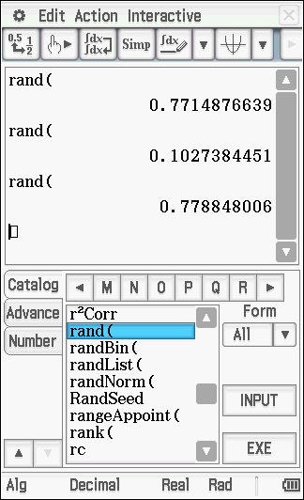
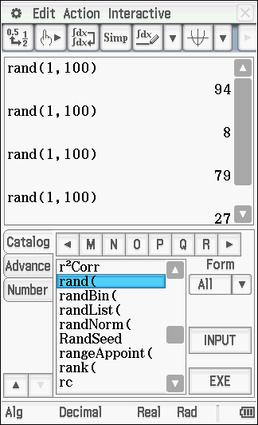
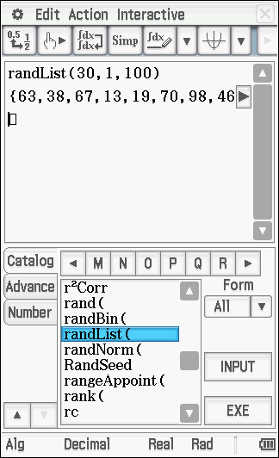
Random Sampling
To generate a random sample, here is what we can do. Supposing the population has 100 people in it and we wanted a sample of 30 people, we could then use a random number generator to generate the sample of 30 without bias.
Under the ‘Catalog’ tab, if you go to the ‘R’ tab you should find the rand() function. Without parameters it will randomly generate a number between 0 and 1 for you.
If parameters are set to generate numbers between 1 to 100 (inclusive) then it will generate integer values within that specified range.
If you want to immediately have 30 numbers generated, using randList() is preferred. The first value is the sample, the next two values are the boundaries.

Slide 7
Systematic Sampling
A random sample can also be selected through a systematic approach, such as lining up everyone in alphabetical order and choosing every 3rd person for the sample.
The only issue with this is: imagine we were sampling components from a machine and every 20th component was faulty (20th, 40th, 60th,…). If we started selecting our sample from the 17th component, and then chose every 25th component from there, notice that no defectives would be included in our sample (17, 42, 67, 92,…).
Cluster Sampling
The population is divided into subgroups or clusters and a set of these clusters will be selected to be the sample.
Example: A well-known fast food chain has 540 stores nationwide and management wishes to survey its customers about a possible new menu.
The management of the fast food chain might randomly select 80 of their stores and conduct a survey using probability sampling methods

Slide 8
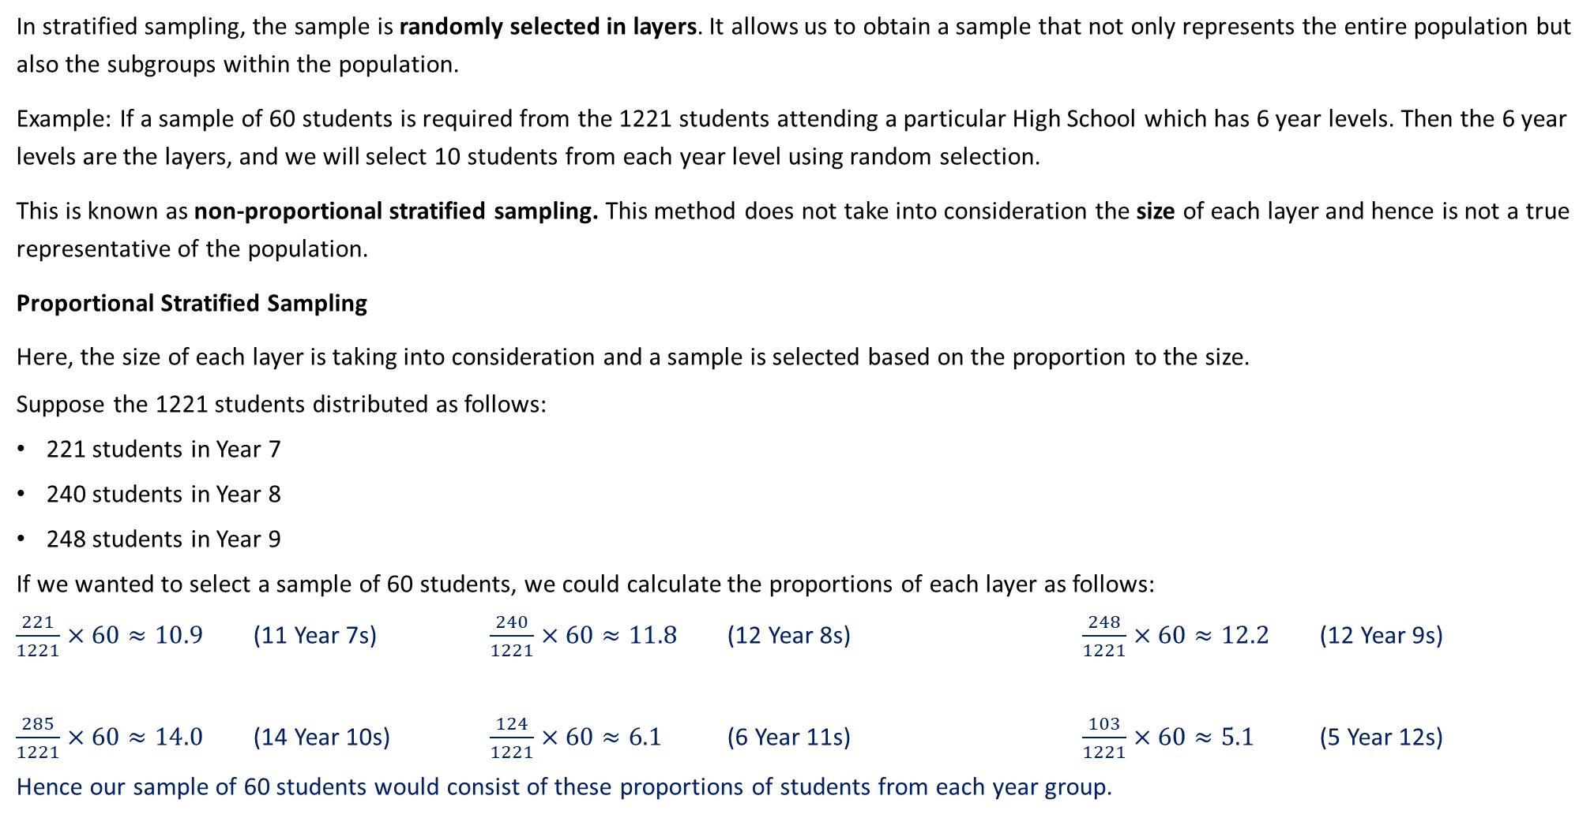
Stratified Sampling
In stratified sampling, the sample is randomly selected in layers. It allows us to obtain a sample that not only represents the entire population but also the subgroups within the population.
Example: If a sample of 60 students is required from the 1221 students attending a particular High School which has 6 year levels. Then the 6 year levels are the layers, and we will select 10 students from each year level using random selection.
This is known as non-proportional stratified sampling. This method does not take into consideration the size of each layer and hence is not a true representative of the population.
Proportional Stratified Sampling
Here, the size of each layer is taking into consideration and a sample is selected based on the proportion to the size.
Suppose the 1221 students distributed as follows:
221 students in Year 7
240 students in Year 8
248 students in Year 9
If we wanted to select a sample of 60 students, we could calculate the proportions of each layer as follows:
$\frac{221}{1221}×60≈10.9$ (11 Year 7s) $\frac{240}{1221}×60≈11.8$ (12 Year 8s) $\frac{248}{1221}×60≈12.2$ (12 Year 9s)
$\frac{285}{1221}×60≈14.0$ (14 Year 10s) $\frac{124}{1221}×60≈6.1$ (6 Year 11s) $\frac{103}{1221}×60≈5.1$ (5 Year 12s)
Hence our sample of 60 students would consist of these proportions of students from each year group.
285 students in Year 10
124 students n Year 11
103 students in Year 12

Slide 9
More Sampling Methods
Convenience samples
Members of convenience sample are chosen because they are readily available
Example: If a sample of 200 students is required then a possible convenience sample would be to head to a high school where the researcher lives and select the first 200 students in that high school
Advantage: Cost and time effective
Disadvantage: Sample is usually bias
Quota samples
Similar to Stratified sampling where population is divided into layers However, instead of a random sampling method involve in selecting the sample in a given layer, a method of convenience sampling is used.
Eg if a sample of 60 students are required from 1221 high school students, then 10 students from each year group are selected using convenience sampling such as the first 10 of each layer to arrive at the high school in the morning. This will form some bias-ness as students arriving later than the 10 students will have no chance of being included in the sample.
Self-selection/Volunteer samples
Members of the population volunteer themselves rather than being selected.
E.g.: If 200 students are required, if a mass email is being sent out, the first 200 students to respond positively to the email will form the sample.
This sampling method usually requires one to send out a mass email, or complete phone-in surveys used by radio or television stations or surveys sent out in newspaper.
Disadvantage: Can be open to abuse as no limit to the number of times a person can complete the survey. Bias-ness towards people with a stronger opinion in the survey are more likely to complete the survey than one who is not.

Slide 10
Guided Practice
For each of the scenarios, match the most appropriate sampling method chosen from the following, given a reason of your choice.
Methods: Volunteer sampling, Quota sampling, Cluster Sampling, Stratified Sampling, Simple Random Sampling, Systematic Sampling, Convenience Sampling
A restaurant owner wants feedback on how their customer service is so he leaves a survey card on each table.
The principal of a large secondary school college wants to find out what students think of the Year 8 mathematics curriculum. He selects three of the eleven Year 8 Mathematics classes and surveys all of the students in those classes.
Volunteer sampling
Customers choose to or choose not to complete the survey card
b) Cluster sampling
Three classes chosen, all students surveyed.

Slide 11
Guided Practice
For each of the scenarios, match the most appropriate sampling method chosen from the following, given a reason of your choice.
Methods: Volunteer sampling, Quota sampling, Cluster Sampling, Stratified Sampling, Simple Random Sampling, Systematic Sampling, Convenience Sampling
A football club wants to survey its fans regarding a new promotion. The promotion team decides to survey 250 fans by using the same proportions of age groups as the population
A university student of a residential college is working on a survey of student’s attitudes towards college administrators, and so he talks to his roommates and other people on the floor of its residential college.
Stratified sampling
Surveys in same proportion
b) Convenience sampling
Sample made up of people within easy reac.

Slide 12
Guided Practice
Avonlorne Secondary College has an enrolment of 424 Year 8 students, 352 Year 9 students, 296 Year 10 students, 284 Year 11 students and 207 Year 12 students. How many students from each year group must be taken to make up a sample of 100 students which reflects the proportion of students in each year group?
Total number of students: $424+352+296+284+207=1563$
Proportion for Year 8: $\frac{424}{1563}×100=27.1273≈27$
Proportion for Year 9: $\frac{352}{1563}×100=22.521≈23$
Proportion for Year 10: $\frac{296}{1563}×100=18.9379≈19$
Proportion for Year 11: $\frac{284}{1563}×100=18.1702≈18$
Proportion for Year 12: $\frac{207}{1563}×100=13.244≈13$

Slide 13
Bias-ness
When a sample has not been formed by random selection, or if the sample is not large enough, it is more likely to introduce bias.
Bias, in the context of sampling in Mathematics, is when a sample statistic over or under-estimates the population parameter.
A sample is deemed bias if members of the population from which the sample is derived either has:
Zero chance of being selected
Probability of these members being selected cannot be determined before hand
Most samples are biased to a certain degree and it is almost impossible to design and conduct a bias-free sample.
There are two main source of bias
Sampling bias (aka selection bias)
Response bias

Slide 14
Selection Bias
Selection bias – occurs when some members of the population are less likely to be included in the sample than others
Under-coverage bias
Occurs when some members of the population are under-represented or over-represented. This is usually a problem in convenience samples.
Voluntary Response or Self-selection bias
Occurs when sample consists of people who volunteer to respond because they have strong opinions on the issue. As such, over-represent individual who have a strong opinions
Self-interest bias or self-serving bias
Occurs when researchers have an interest in the outcome, hence judgements are shaded by their own interest
Non-response bias
When chosen individuals for the sample are unwilling or unable to participate. Hence the sample is no longer a representative of the population

Slide 15
Response Bias
Response bias – occurs when participants give inaccurate response for any reason. Eg. Participants in a survey deliberately give false or misleading answer.
Leading question bias
Occurs when the wording of the question prompts the respondent to answer in a particular way
Eg. “How was the car going when it smashed into the bus?” – Implies that the car was at fault and suggests that the car was travelling at a high speed. How can we reword this question?
“How fast was each vehicle travelling when the accident occurred?”- Does not assign any blame or pre-judgement.
Social desirability bias
Respondents answer questions in a manner that will be view favourably by others instead of choosing response that are reflective of their true feelings.
This becomes an issue when it involves socially sensitive topics like religion, politics, drug use, race, cheating etc
Acquiescence bias
Respondents to a survey have a tendency to agree with all the questions

Slide 16
Reducing Bias
Select participants from the target population randomly such as using stratified random sampling.
Have a large sample size. The more participants you take in your sample, the more information you will have and the better your estimates will be
Note: If your sampling method is flawed, then increasing the sample size will not reduce bias-ness.

Slide 17
Guided Practice
In order to determine the sort of film in which to invest his money, a producer waits outside a theatre and asks people as they leave whether they prefer comedy, drama, horror or science fiction. Do you think this is an appropriate way of selecting a random sample of movie goers? Explain your answer.
No, the sample will be biased towards the type of movie being shown.
In order to survey the attitude of parents to the current uniform requirements, the principal of a school selected 100 students at random from the school roll, and then interviewed their parents. Do you think this group of parents would form a simple random sample?
No, a parent’s chance of selection depends on how many children they have at the school.

Slide 18
Guided Practice
A pharmaceutical company wishes to gather information on a new form of headache tablets. Comment on whether there is any bias in the following sampling methods, giving reasons for your answers.
People were surveyed outside a dental clinic.
Biased, as dental patients are more likely to have headaches due to dental pain on average.
People waiting at a central bus station in the city were selected.
No bias, as there is no connection between headaches and mode of travel in general. IF there was bias, it would only be in that not all people take public transportation and so not every member of the population would have equal contribution to the survey.
People were contacted using random mobile numbers.
Biased, as not every person in the population has access to a mobile phone. Some may only use landlines.

Slide 19
Guided Practice
On a particular media website, readers were invited to respond to the following question: Do you agree that asylum seeker boats should be forcefully turned away from Australian territorial waters? Comment on this method of sampling public opinion on the matter and discuss possible sources of bias.
On a popular celebrity cooking show, viewers were invited to SMS their choice of one of two celebrities for the title of ‘Australia’s favourite celebrity chef’. Comment on this method of polling for the ‘title’ and discuss the possible sources of bias.
An expensive private school (single sex) conducted a phone poll on the families of 200 of its students to gauge the proportion of families supporting the extending of school hours for the students. Comment on the choice of sampling and discuss possible sources of bias and ways to reduce them.

Slide 20
Guided Practice
On a particular media website, readers were invited to respond to the following question: Do you agree that asylum seeker boats should be forcefully turned away from Australian territorial waters? Comment on this method of sampling public opinion on the matter and discuss possible sources of bias.
This is an example of self-selection/voluntary response sampling and hence, it is not random. Subsequently, one possible source of bias is non-response bias (not every reader will participate in the survey if they can ‘choose’ to participate).
Not all of the Australian population would use this particular website, and hence individuals who do not have internet access, or who may not understand English, are neglected from the sample.

Slide 21
Guided Practice
On a popular celebrity cooking show, viewers were invited to SMS their choice of one of two celebrities for the title of ‘Australia’s favourite celebrity chef’. Comment on this method of polling for the ‘title’ and discuss the possible sources of bias.
This is another example of self-selection/voluntary response sampling and again, it is not random. The results will be distorted due to more responses from ‘interested’ groups, and no responses from viewers who do not want to participate in the poll.
Additionally, not all individuals may have access to a mobile phone to participate in the poll.

Slide 22
Guided Practice
An expensive private school (single sex) conducted a phone poll on the families of 200 of its students to gauge the proportion of families supporting the extending of school hours for the students. Comment on the choice of sampling and discuss possible sources of bias and ways to reduce them.
This is an example of convenience sampling, as the school is calling their students’ parents for an opinion so it is easy and efficient. However, the timing at which the calls are made will cause possible sources of bias as working parents may not be able to be contacted. If they are, their opinions may be distorted if they are interrupted during their working hours (i.e. under stress etc.).
Furthermore, not all parents are English-speaking and if the poll is done in English, this would cause distorted results.
To reduce this bias, the school should consider ‘categories’ of parents to ensure they provide equal opportunities for working parents and stay-at-home parents to response to the poll.

Slide 23
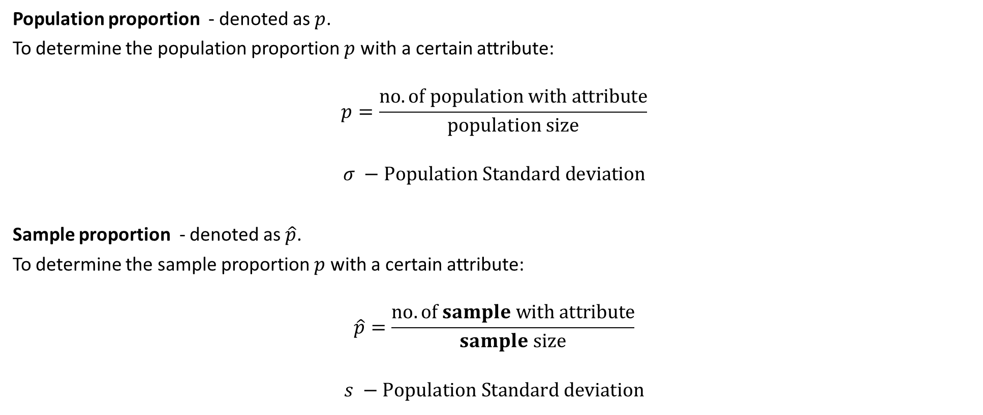
Sample Proportion
Population proportion - denoted as $p$.
To determine the population proportion $p$ with a certain attribute:
$$p=\frac{no. of population with attribute}{population size}$$
$$σ −Population Standard deviation$$
Sample proportion - denoted as $\hat{p}$.
To determine the sample proportion $p$ with a certain attribute:
$$\hat{p}=\frac{no. of sample with attribute}{sample size}$$
$$s −Population Standard deviation$$

Slide 24


Guided Practice
In a certain school, 35% of the students travel on the school bus. A group of 100 students were selected in a random sample, and 42 of them travel on the school bus. In this example:
What is defined to be the population?
What is the value if the population proportion?
What is the value of the sample proportion?
The population is all students in this school
$$p=0.35$$
$$\hat{p}=0.42$$

Slide 25
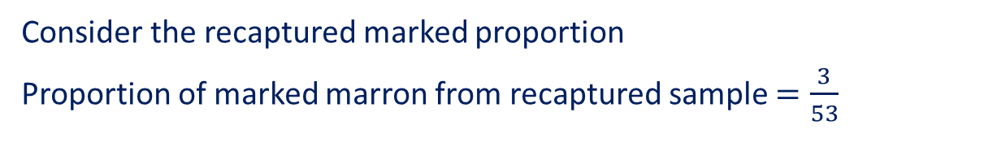
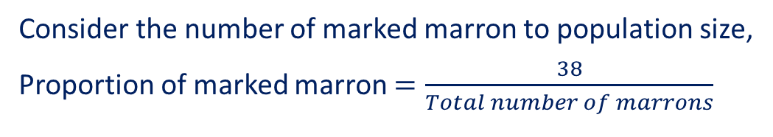



Estimation – Guided Practice
To estimate the number of marron in his dam, a famer caught 38 marron marked them and then released them back into the dam. After a few days, the farmer took a second sample of 53 marron from the dam and found amongst them three marked marron. Based on these figures, estimate the number of marron in this dam at this time.
Consider the number of marked marron to population size,
Proportion of marked marron $=\frac{38}{Total number of marrons}$
Consider the recaptured marked proportion
Proportion of marked marron from recaptured sample $=\frac{3}{53}$
To estimate the number of total marrons, we approximate:
$$\frac{No. of total marked marrons}{Popoluation size}≈\frac{No of sample marked marrons}{Sample size}$$
$$\frac{38}{Popoluation size}≈\frac{3}{53}$$
$$Population size≈\frac{53}{3}×38=671 marrons$$

Slide 26
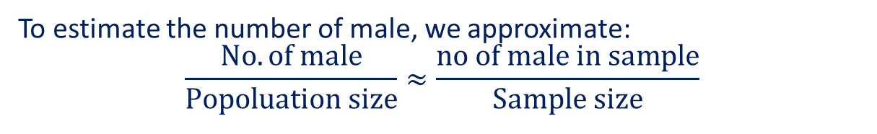
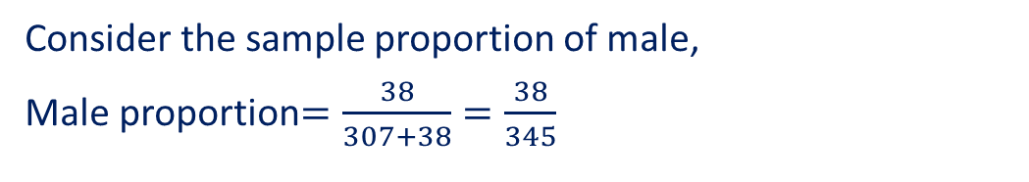
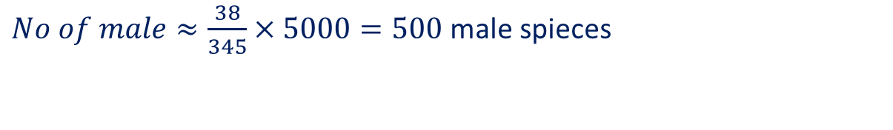

Estimation – Guided Practice
5000 fingerlings (young fish) were released into a tank and a sample of fingerlings was taken from this tank and sexed. It was found that 307 of the fingerlings were female and 38 were male. Estimate the number of male fingerlings in the tank.
Consider the sample proportion of male,
Male proportion$=\frac{38}{307+38}=\frac{38}{345}$
To estimate the number of male, we approximate:
$$\frac{No. of male}{Popoluation size}≈\frac{no of male in sample}{Sample size}$$
$$\frac{No. of male}{5000}≈\frac{38}{345}$$
$No of male≈\frac{38}{345}×5000=500$ male spieces

Slide 27
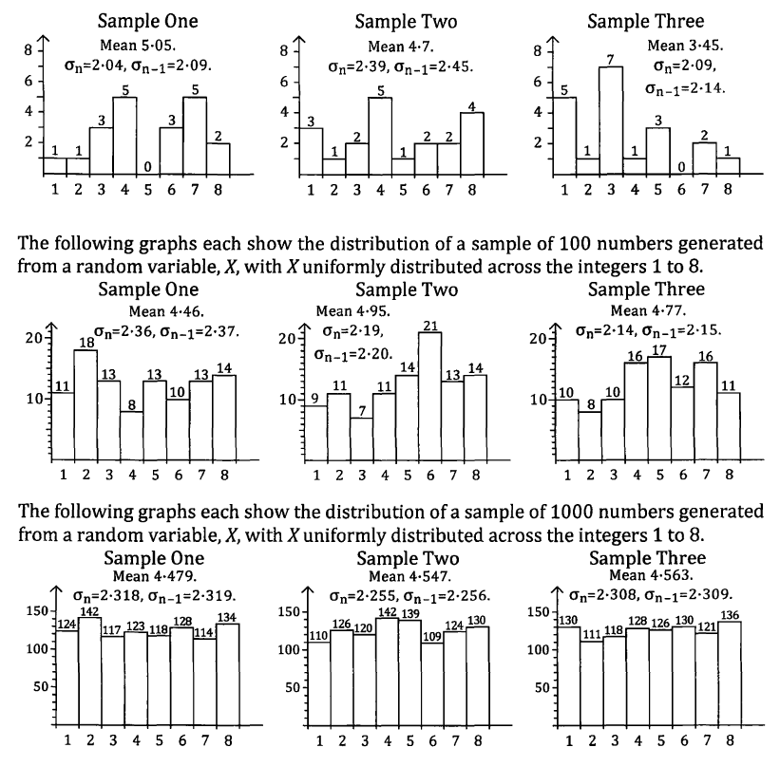
Variability of Samples
The first row of graphs show the distributions of a sample of 20 numbers generated from a random variable, X, with X uniformly distributed across the integers 1 to 8.
Theoretically, we expect the chances of each value to be equally likely (since it is uniform), and we also expect the shape of the distribution to be rectangular. We also expect the mean to be 4.5.
However, it makes sense that different samples (taken by experimentation) will show variations.

Slide 28
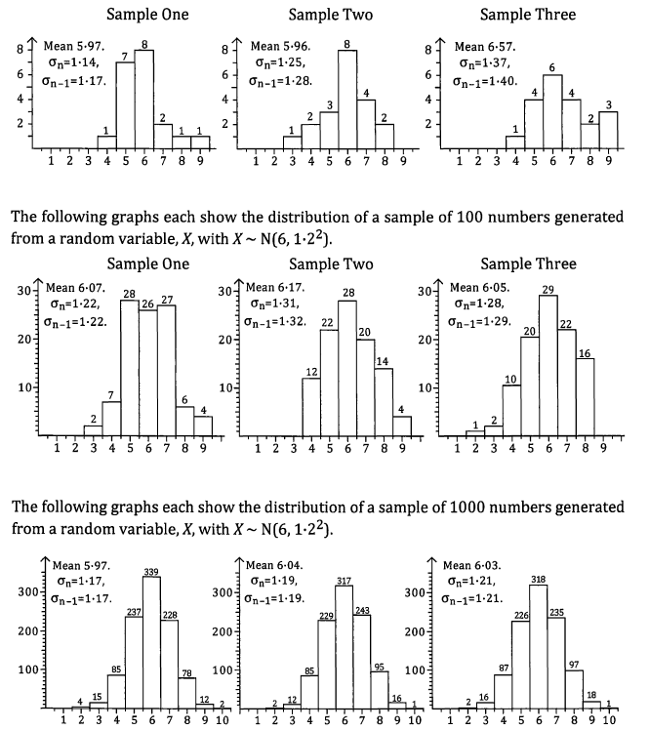
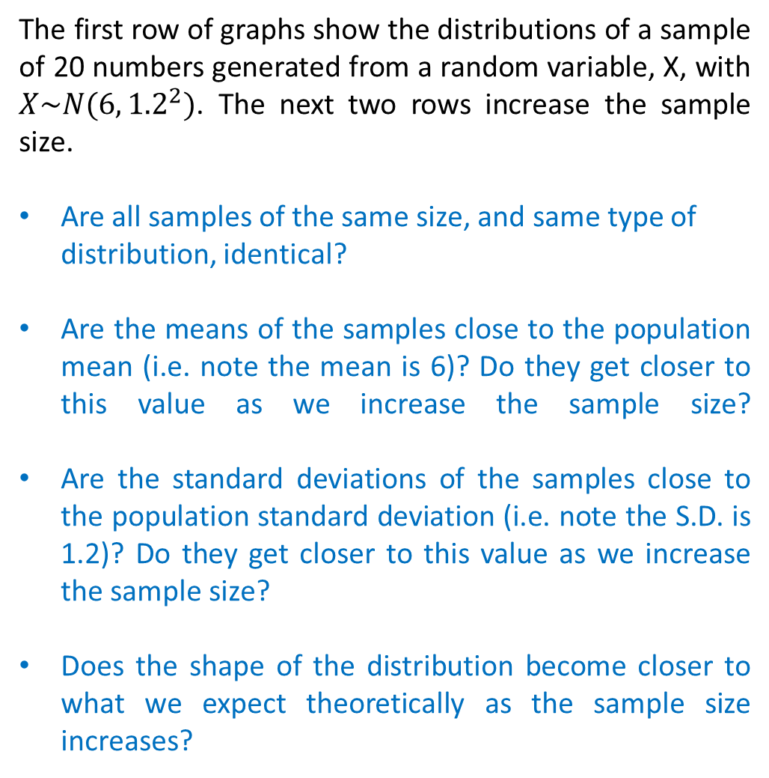
Variability of Samples (Food for thought)
The first row of graphs show the distributions of a sample of 20 numbers generated from a random variable, X, with $X\sim N(6,{1.2}^{2})$. The next two rows increase the sample size.
Are all samples of the same size, and same type of distribution, identical?
Are the means of the samples close to the population mean (i.e. note the mean is 6)? Do they get closer to this value as we increase the sample size?
Are the standard deviations of the samples close to the population standard deviation (i.e. note the S.D. is 1.2)? Do they get closer to this value as we increase the sample size?
Does the shape of the distribution become closer to what we expect theoretically as the sample size increases?

Slide 29
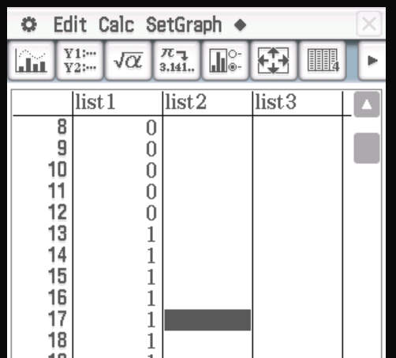
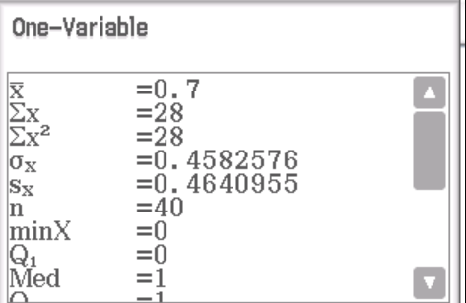
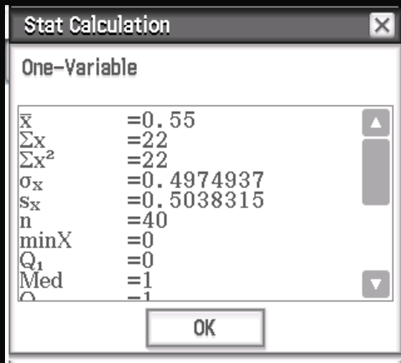


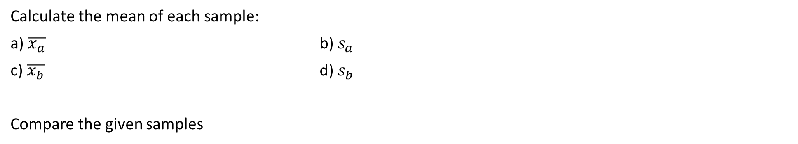
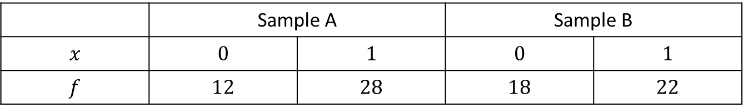
Guided Practice
Consider the following samples of size 40 obtained from a Bernoulli distribution with $p=0.6$.
 | Sample A |  | Sample B
$$x$$ | $$0$$ | $$1$$ | $$0$$ | $$1$$
$$f$$ | $$12$$ | $$28$$ | $$18$$ | $$22$$
$$μ=0.6$$
Theoretically, what is the mean of this sample size?
Calculate the mean of each sample:
a) $\overline{x_{a}}$ b) $s_{a}$
c) $\overline{x_{b}}$ d) $s_{b}$
Compare the given samples
$$=\frac{28}{40}=0.7$$
Sample A has a higher mean
but sample B has a larger spread

Slide 30
Independent Practice
Complete Jklup Ex 5A – 5D
Cambridge Ex 12A

